Slide 1
Linux Kernel Development 03
工海系 大四 朱紹勳

Slide 2
 | Linux Kernel Dev 3rd | Understand Linux Kernel 3rd | Source Code Example
Process Management | Chapter 3 | Chapter 3
Process Scheduling | Chapter 4 | Chapter 7
Kernel Synchronization | Chapter 9, 10 | Chapter 5

Slide 3
Enter & Exit of System Call

Slide 4
int0x80
Entering
set_system_gate(0x80, &system_call);
system_call()
system_call:
pushl %eax
SAVE_ALL
movl $0xffffe000, %ebx
/* or 0xfffff000 for 4-KB stacks */
andl %esp, %ebx cmpl $NR_syscalls, %eax
jb nobadsys
movl $(-ENOSYS), 24(%esp)
jmp resume_userspace
nobadsys:
call *sys_call_table(0, %eax, 4)
Exiting
system_call()
movl %eax, 24(%esp)
cli
movl 8(%ebp), %ecx
testw $0xffff, %cx
je restore_all

Slide 5
sysenter, sysexit
Use 3 special registers: cs <- SYSENTER_CS_MSR eip <- SYSENTER_EIP_MSR esp <- SYSENTER_ESP_MSR ss <- SYSENTER_CS_MSR + 8
vsyscall:
CPU support
__kernel_vsyscall:
int $0x80
ret
CPU not support
__kernel_vsyscall:
pushl %ecx
pushl %edx
pushl %ebp
movl %esp, %ebp
sysenter
Entering
eax <- #syscall
__kernel_vsyscall
save registers to user stack
sysenter_entry:
movl -508(%esp), %esp
sti pushl $(__USER_DS)
pushl %ebp
pushfl
pushl $(__USER_CS)
pushl $SYSENTER_RETURN movl (%ebp), %ebp
Exiting
SYSENTER_RETURN:
popl %ebp
popl %edx
popl %ecx
ret

Slide 6
Process Management

Slide 7
Process Termination
do_group_exit()
terminate while thread group. Extension from do_exit()
do_exit()
Set flag(proc desc.) to PF_EXITING
Call del_timer_sync()
Call exit_mm(), exit_sem(), exit_files(), exit_fs()…
exit_notify()
update family relationship(init)
SIGCHLD
if _exit_signal == 1 ? EXIT_DEAD : EXIT_ZOMBIE
schedule() // to switch to new process
6. release_task() delete proc desc. (before then, we can still access info of dead process)
__exit_signal()
wait() wait4(), waitpid()
Parentless Task: exit_notify(),
forget_original_parent(), find_new_reaper(), ptrace_exit_finish()

Slide 8
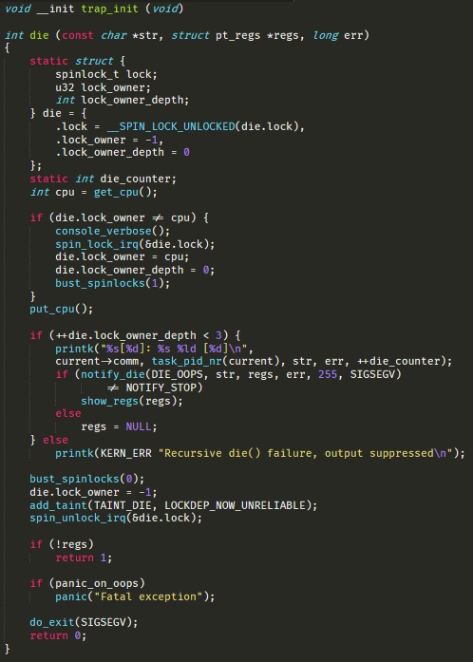
arch/ia64/kernel/traps.c

Slide 9
Thread
Actually a light-weighted (specialized) process
Thread Creation
clone(CLONE_VM | CLONE_FS | CLONE_FILES | CLONE_SIGHAND, 0); // clone(SIGCHLD, 0);
flags are defined in <linux/sched.h>
Kernel Thread
Perform some operations in the background(in kernel)
declared in <linux/kthread.h>
struct task_struct *kthread_create(int (*threadfn)(void *data), void *data, const char namefmt[], ...)
struct task_struct *kthread_run(int (*threadfn)(void *data), void *data, const char namefmt[], ...)
ksoftirqd is an example

Slide 10
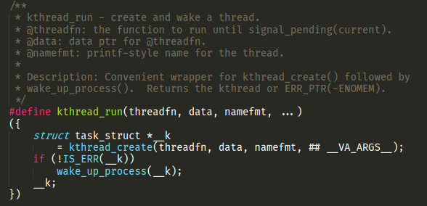

Slide 11
Process Scheduling

Slide 12
Intro of Linux Process Scheduling
preemptive & non-preemptive(yield)
History of Linux Process Scheduling Algorithm:
1. Simple (scan the process linked list and calculate the priority)
2. O(1) algorithm: ideal for larger server workload
3. Rotating Staircase Deadline Scheduler
(Known as Completely Fair Scheduler, CFS)
I/O-Bound Vs. Processor-Bound
Interactive processes Vs. Batch processes Vs. Real-time processes
Performance bottleneck is limited by IO Request or Processor Computing
Trade off between two goals: low latency & high throughput

Slide 13
Process Priority & Time slice
The approaches of priority determination:
Real Time Priority(0~99) & Nice Value(100 ~ 139)
Time Slice
Short → waste time on process overhead, I/O-bound prefer
Long → poor interactive performance, CPU-bound prefer
Linux assigns processes a proportion of the processor, which related to the nice value.
SCHED_FIFO, SCHED_RR(Round Robin), SCHED_NORMAL
Use swapper (PID 0) to execute scheduling

Slide 14
Functions Used by the Scheduler
scheduler_tick()
Keeps the time_slice counter of current up-to-date
try_to_wake_up(p, TASH_NORMAL, 0);
Awakens a sleeping process
recalc_task_prio()
Updates the dynamic priority of a process
schedule()
Selects a new process to be executed
load_balance()
Keeps the runqueues of a multiprocessor system balanced

Slide 15
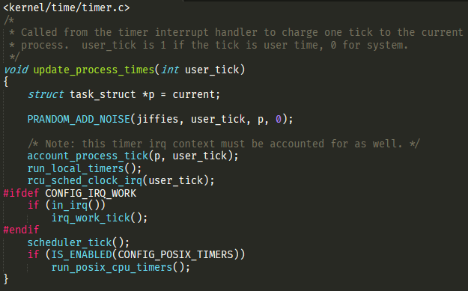
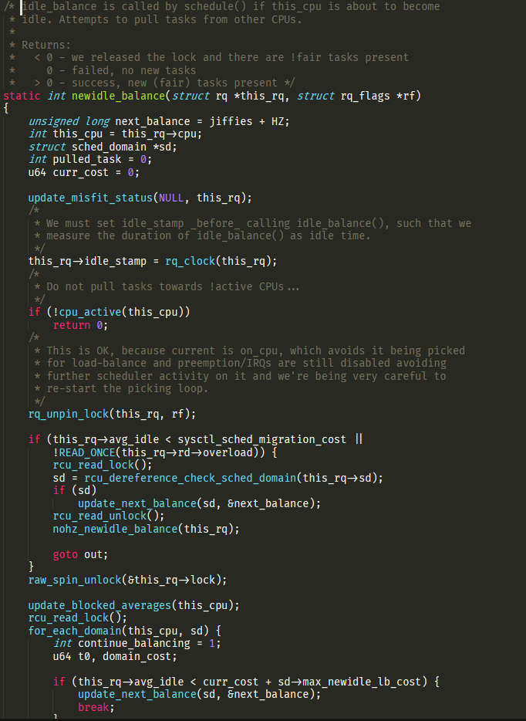
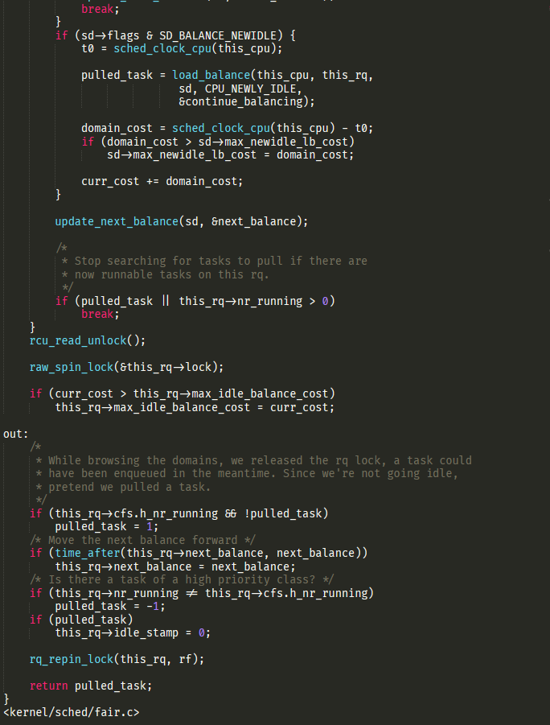

Slide 16
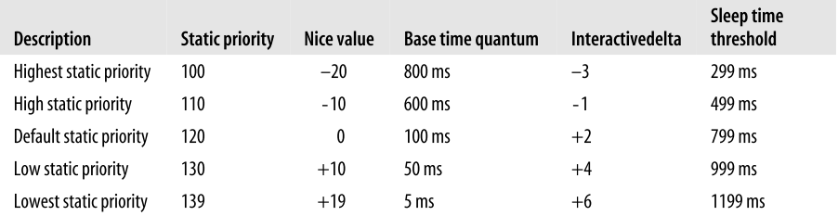
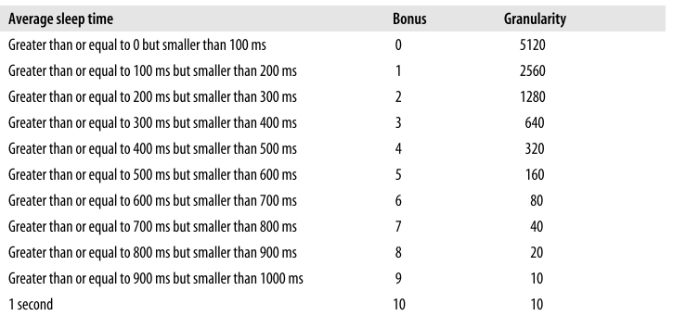
Normal Scheduling vs Real Time Scheduling
Normal Scheduling
Can use system call to change priority nice() and setpriority()
Real Time Scheduling
SCHED_FIFO, SCHED_RR (SCHED_RR have time slice)
Can use system call to change priority sched_setparam() sched_setscheduler()
context switch in following situations
preempt by higher priority process
process block and sleep
process stop or be killed
yield
Finish time slice in SCHED_RR

Slide 17
Intro of Completely Fair Scheduler(CFS)
defined in <kernel/sched/fair.c>
Run each process
round-robin
selecting process that has run the least.
Calculates how long a process should run as a function of the total number of runnable processes.
nice value is only use for weighting the proportion of processor
CFS sets a target for its approximation of the “infinitely small” scheduling duration in perfect multitasking.
No time slice concept in CFS
The minimum granularity : 1ms

Slide 18
Implement of CFS
Time Accounting
Process Selection
The Scheduler Entry Point
Sleeping and Waking Up

Slide 19
Time Accounting
Scheduler Entity Structure
defined in <linux/sched.h>, embedded in task_struct of process
Virtual Runtime (ns)
= Actual runtime normalized (or weighted) by the # runnable process
To approximate the “ideal multitasking processor” in CFS

Slide 20
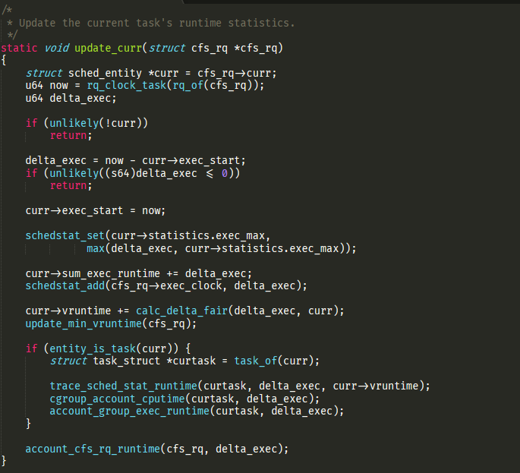
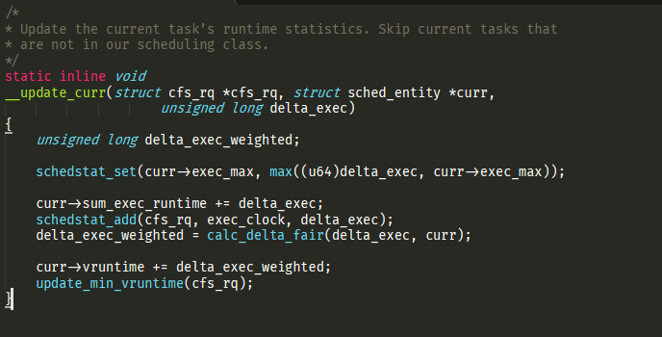

Slide 21
Process Selection
Simply find the process with smallest vruntime
__pick_next_entity(), defined in <kernel/sched_fair.c>
We use RBtree, the key of each process are the vruntime
The far left node is the next process for run
The Scheduler Entry Point
schedule(), defined in <kernel/sched.c>
The schedule() will call pick_next_task()

Slide 22
Sleeping and Waking Up
State : TASK_INTERRUPTIBLE(wake up prematurely & response) or TASK_UNINTERRUPTIBLE()
Waiting Queue
Waking Up
use wake_up(), nested call try_to_wake_up()
set TASK_RUNNING & use enqueuer_task to insert task to RBtree

Slide 23
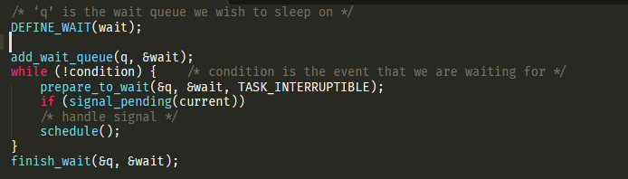
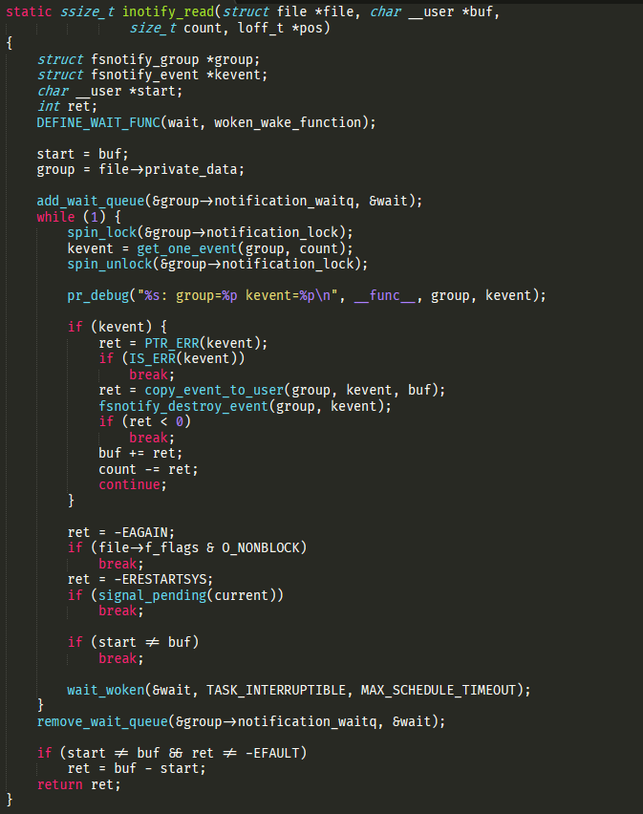
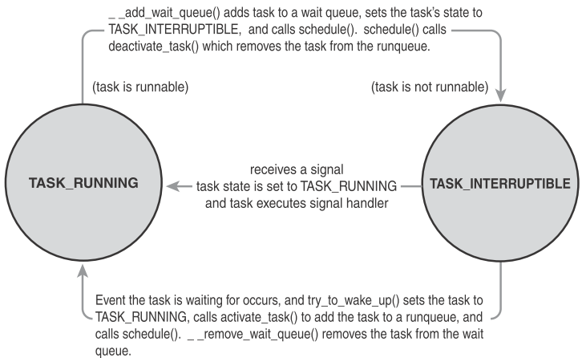
Notes:
Creates a wait queue entry by macro DEFINE_WAIT().
2. Adds itself to a wait queue via add_wait_queue() .This wait queue awakens the process when the condition for which it is waiting occurs.
3. Calls prepare_to_wait() to change the process state to either TASK_INTERRUPTIBLE or TASK_UNINTERRUPTIBLE.
4. If the state is set to TASK_INTERRUPTIBLE , a signal wakes the process (spurious wake), check and handle signals.
When the task awakens:
if condtion_true ? exit() loop : call schedule() & repeat
6. If true, the task sets itself to TASK_RUNNING and removes itself from the wait queue via finish_wait() .

Slide 24
Preemption and Context Switching
Schedule() → context_switch(), defined in <kernel/sched.c>
switch_mm(), switch process in virtual memory
switch_to(), save & restore stack information and the processor registers
Use need_resched to check the needed of rescheduling
User preemption
(1).Return from a system call (2).Return from an interrupt handler
check need_resched, if set ? find another process, entry.s
Kernel preemption
(1) interrupt handler exits before returning to kermel (2)Kernel code becomes preemptible (3)kernel explicitly calls schedule() (4)kernel blocks
preempt_count, lock++, release—, != 0 means has holding lock

Slide 25
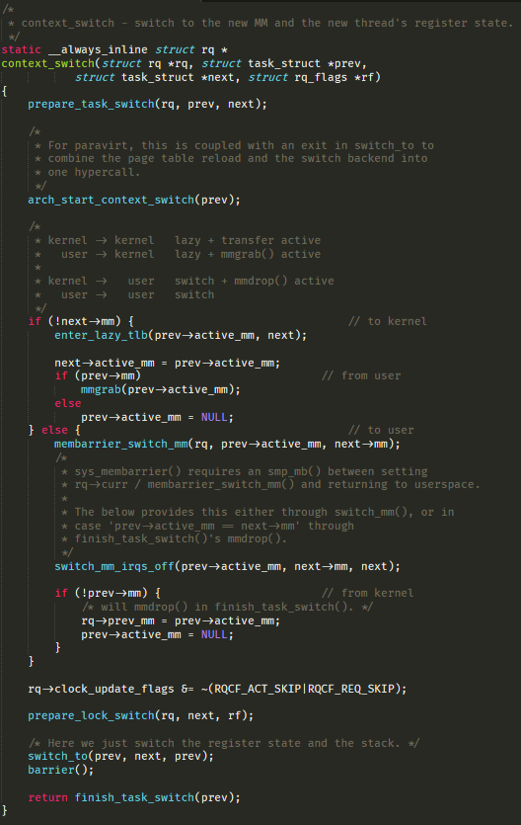

Slide 26
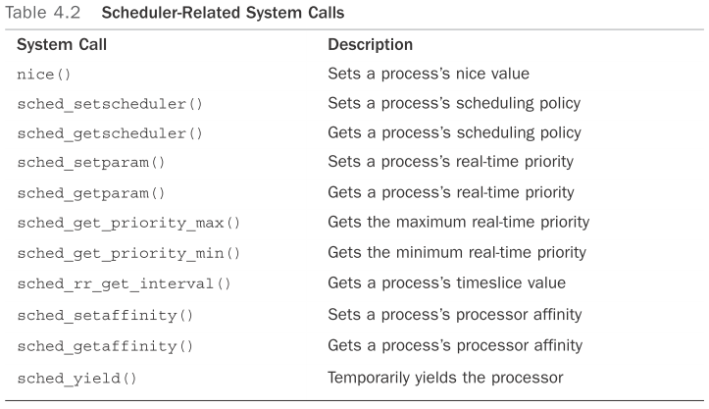
Scheduler-Related System Calls

Slide 27
Kernel Synchronization

Slide 28
Intro of Synchronization
Critical Section(CS) & Race Condition
Lock, atomic operation
Concurrency
Cause by:
interrupt
softirq & tasklet
Kernel preemption
Sleeping and synchronization with user-space
Symmetrical multiprocessing(different cpu run same process)
Solution:
interrupt-saft
SMP-safe
Preempt-safe

Slide 29
Intro of Synchronization
Deadlock
some simple rules:
Implement lock ordering.
Prevent starvation.
Design for simplicity
lock contention
High contented lock may lead to overhead
scalability
The granularity of locking

Slide 30
Solutions for Synchronization
Atomic Operation
Spinlock
Reader-Writer Spinlock
Semaphore
Reader-Writer Semaphores
Mutexes
Completion Variables
BKL: The Big Kernel Lock
Sequential Locks
Preemption Disable
Ordering & Barriers

Slide 31

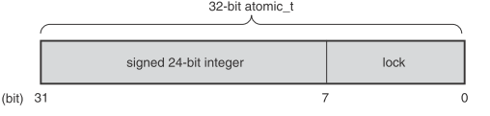

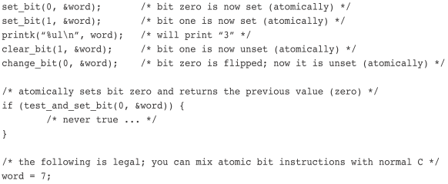
Atomic Operation
1. Operates on integers 2. Operates on individual bits
atomic_t data type (instead of int), defined in <linux/types.h> :
Ensures the compiler does not optimize access to the value
in old Linux, atomic_t has only 24 bits for integer operation
atomic64_T
low cost

Slide 32
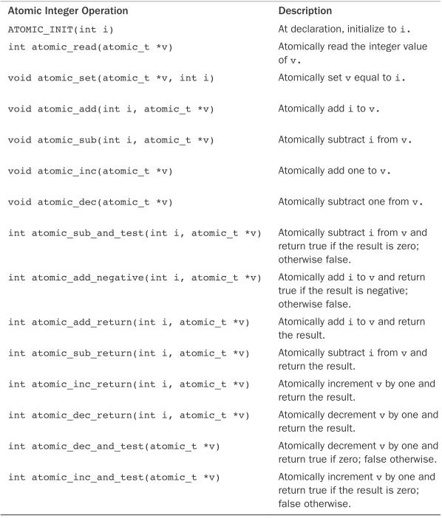
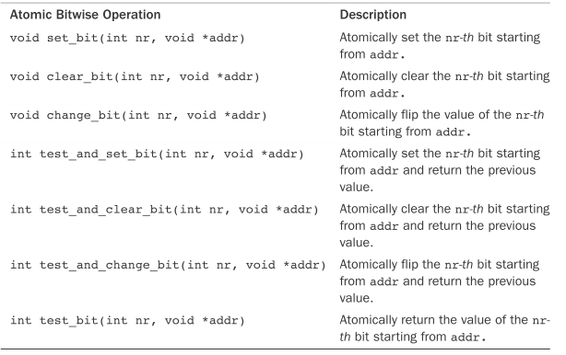
<asm/atomic.h>

Slide 33
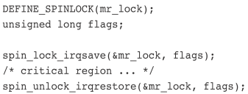
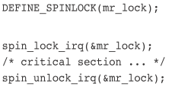

Spinlock
Atomic can only work for variables. Complicate function can us lock
simple, busy-waiting, should not hold for a long time (t < 2*context sw)
Not Recursive
<linux/spinlock.h>

Slide 34
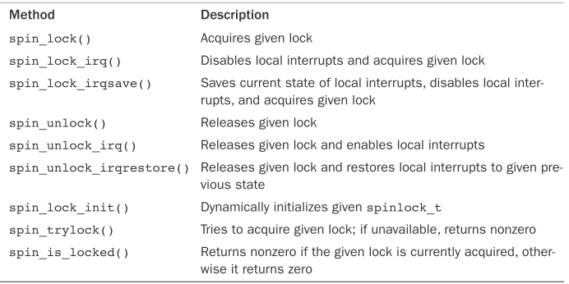
Initialize:
#DEFINE_SPINLOCK(my_lock); or
spin_lock_init(spinlock_t *lock);
Bottom Halve:
spin_lock_bh(spinlock_t *lock);
spin_unlock_bh(spinlock_t *lock);
Bottom half preempt process context code,
if data share between BH process context, we use:
1. A lock 2. Disable bottom halves. to protect
Interrupt handler may preempt a bottom half,
if data share between interrupt handler and a BH, we use:
1. A lock 2. Disable interrupt. to protect

Slide 35
Read-Write Lock
The RW lock of linux
One or more readers can concurrently hold the reader lock
Only one write lock (shared and exclusive form)
DEFINE_RWLOCK(mr_rwlock);
read_lock(&mr_rwlock);
/* critical section (read only)*/
read_unlock(&mr_rwlock);
write_lock(&mr_rwlock);
/* critical section (read and write)*/
write_unlock(&mr_lock);
Warning:
A read-write lock pair may cause deadlock
read_lock(&mr_rwlock);
write_lock(&mr_rwlock);
If cannot serperate read & write:
use spinlock

Slide 36
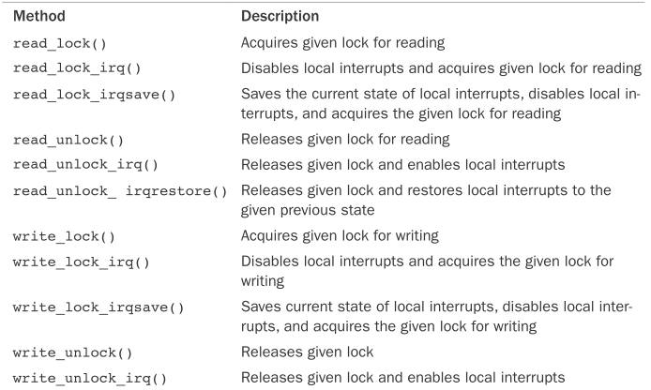
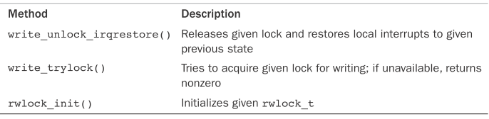
wrIte(X) : read(O)
use read_lock() is enough
write(O) : read(O)
disable interrupts for write access
use write_lock_irqsave()
Reader favorite
May lead to write starvation

Slide 37
Semaphore
Sleeping locks, push to wait queue to sleep if the lock is occupied
Wake up if when the semaphore is released.
Lead to:
Better CPU utility
Higher cost than spinlock (the waiting time is important)
Obtain semaphore in process not interrupt context(not schedulable).
Initialize: struct semaphore name;
sema_init(&name, count);
sema_init(sem, count);
static DECLARE_MUTEX(name); // binary semaphore
init_MUTEX(sem);

Slide 38
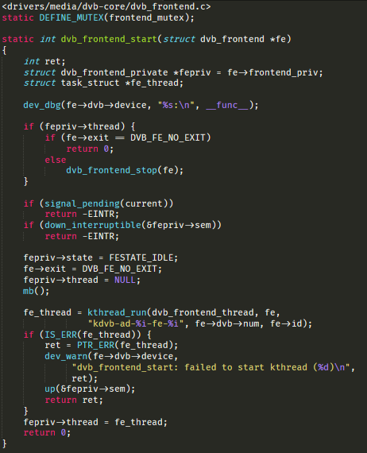
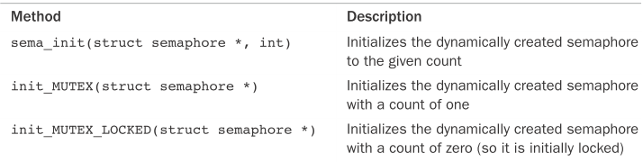
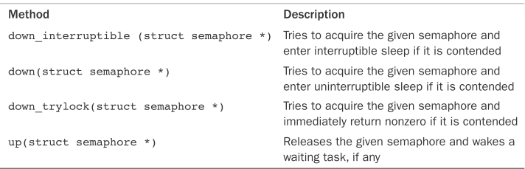
Initialize counting semaphore
struct semaphore name;
sema_init(&name, count);
sema_init(sem, count);
static DECLARE_MUTEX(name); // binary semaphore
init_MUTEX(sem);
Application
/* define and declare a semaphore, named mr_sem, with a count of one */ static DECLARE_MUTEX(mr_sem); /* attempt to acquire the semaphore ... */ if (down_interruptible(&mr_sem)) { /* signal received, semaphore not acquired ... */ } /* critical region ... */ /* release the given semaphore */ up(&mr_sem);

Slide 39
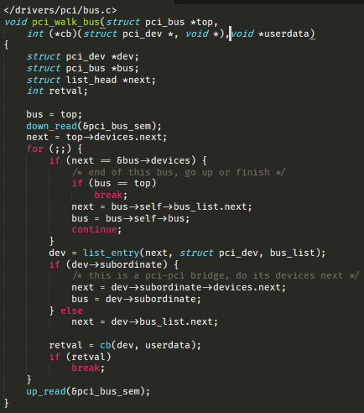
Read-Write Semaphore
Initialize:
static DECLARE_RWSEM(mr_rwsem);
init_rwsem(struct rw_semaphore *sem)
Functions
down_read(&mr_rwsem);
up_read(&mr_rwsem);
down_write(&mr_rwsem);
up_write(&mr_sem);
down_read_trylock(*sem);
down_write_trylock(*sem);
downgrade_write(*sem); // dynamically turn write to read

Slide 40
Mutex
Initialize:
DEFINE_MUTEX(name);
mutex_init(&mutex);
Not just binary semaphore, STRICTER
Lock, unlock from the same context.
Cannot exit while holding a mutex.
Cannot used by an interrupt handler or bottom half
…
Prefer using mutex than semaphore
Functions
mutex_lock(struct mutex *)
mutex_unlock(struct mutex *)
mutex_trylock(struct mutex *)
mutex_is_locked (struct mutex *)

Slide 41
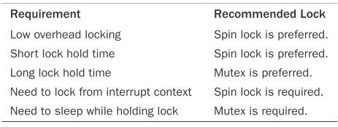

Slide 42
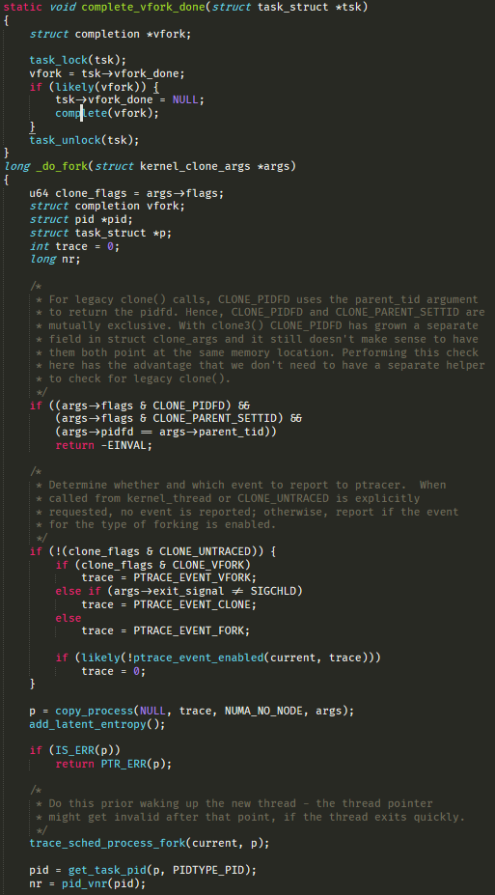
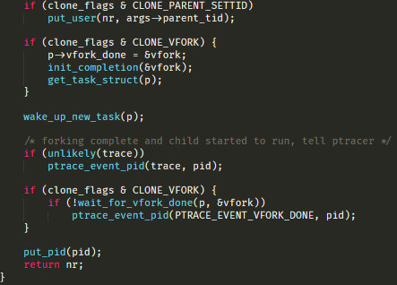
Completion Variables
one task needs to signal to the other that an event has occurred
Initialize:
DECLARE_COMPLETION(mr_comp);
init_completion();
Functions
init_completion(struct completion *)
wait_for_completion(struct completion *)
complete(struct completion *)

Slide 43
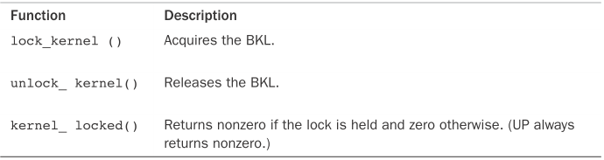
Big Kernel Lock
A Transition mechanism from linux 2.0 to 2.2
Fine-grained locking for SMP
You can sleep while holding the BKL. The lock is automatically dropped when the task is unscheduled and reacquired when the task is rescheduled
=> avoid deadlock cause by sleeping.
The BKL is a recursive lock.
You can use the BKL only in process context, not interrupt context

Slide 44
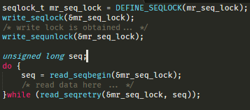
Sequential Locks
A better method for writer, which readers can not starve writer
Reader may read multiple times to get the latest version
The sequence number increase when writing
Same number: not interrupt yet; Odd: is writing; Even: finish writing

Slide 45
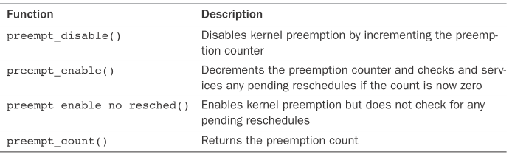
Preemption Disabling
Kernel is preemptive, may preempt when another process in CS
1. spinlock(preempt-free) 2. preempt_disable()

Slide 46
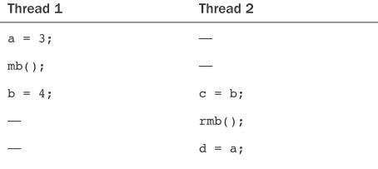

Ordering and Barriers
compiler and processor can reorder reads and writes for performance reasons (compiler time, runtime)
barrier is use as a block

Slide 47
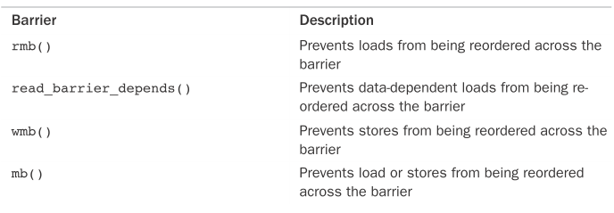
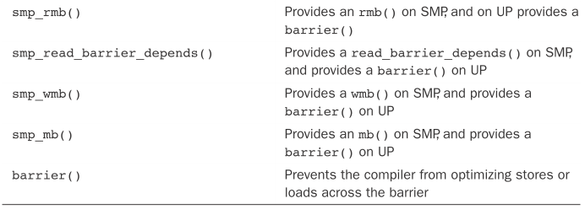

Slide 48
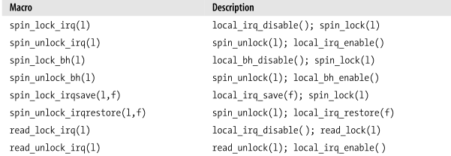
Protect a data accessed by interrupts
If multiple irq access data at same time…, even multiple cpu
In uniprocessor, disable interrupt in CS
In multiprocessor,
disabling local interrupts + use spin lock to protect data.

Slide 49
